Slide 1

Football Manager Dataset
Player Ability Analysis
BFOR 516 Project:
Nicholas Lopez, Sajjad Khan, Jackson Nahom, Omer Keskin

Slide 2

Dataset
Football Manager 2020 Dataset (Kaggle)
This dataset provides a collection of football players and their stats, such as age, position, club, nationality, value, wage, all player attribute components.
Size: 35MB, 64 Columns, 144750 rows/players
Key Columns: Wage, Value, Age, Long Shots, Long Throws, Passing, Dribbling, Aggression, Stamina, etc. (56 of the columns were used)
Notes:
https://www.kaggle.com/ktyptorio/football-manager-2020

Slide 3
What is this Data
Football Manager is a simulation game that could best be described as a spreadsheet simulator
The data used comes from a network of 13,000 scouts of at varying levels that send reports to the developer Sports Interactive
The data is so expansive and detailed that some high level clubs pay Sports Interactive for access to their database
Everton publicly signed a database deal with Sports Interactive back in 2008
Notes:
https://www.footballmanagerblog.org/2018/03/how-football-manager-is-used-in-real-life.html
https://www.theguardian.com/technology/2014/aug/12/why-clubs-football-manager-scouting-tool

Slide 4
Business Questions
Can we predict a player's Current Ability?
Can we predict a player's Potential Ability?
Can we predict which players are in a Top 10 league?
Notes:
https://www.kaggle.com/ktyptorio/football-manager-2020

Slide 5
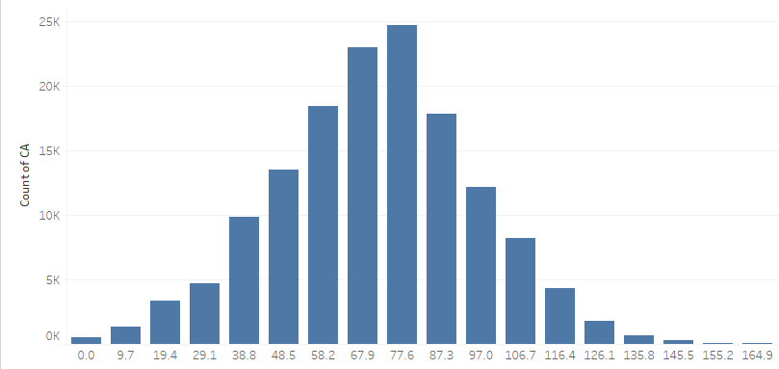
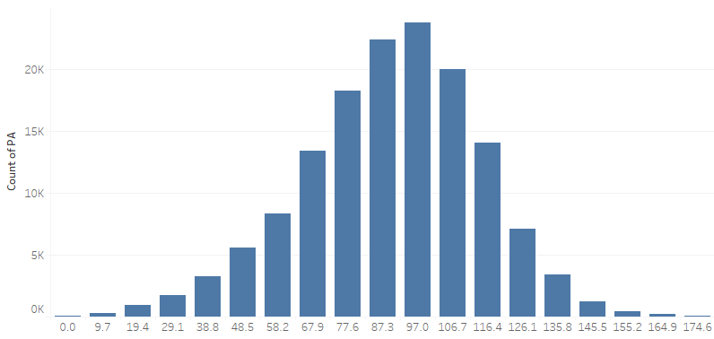
Summary Statistics
Current Ability
Potential Ability

Slide 6
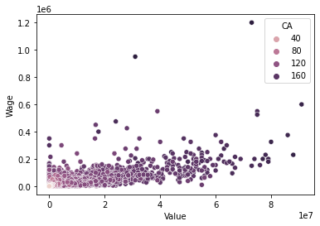
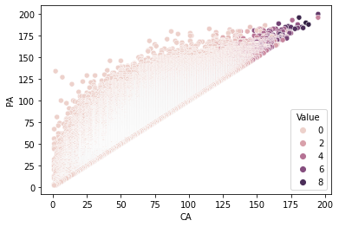
Current Ability, Potential Ability, and Value

Slide 7
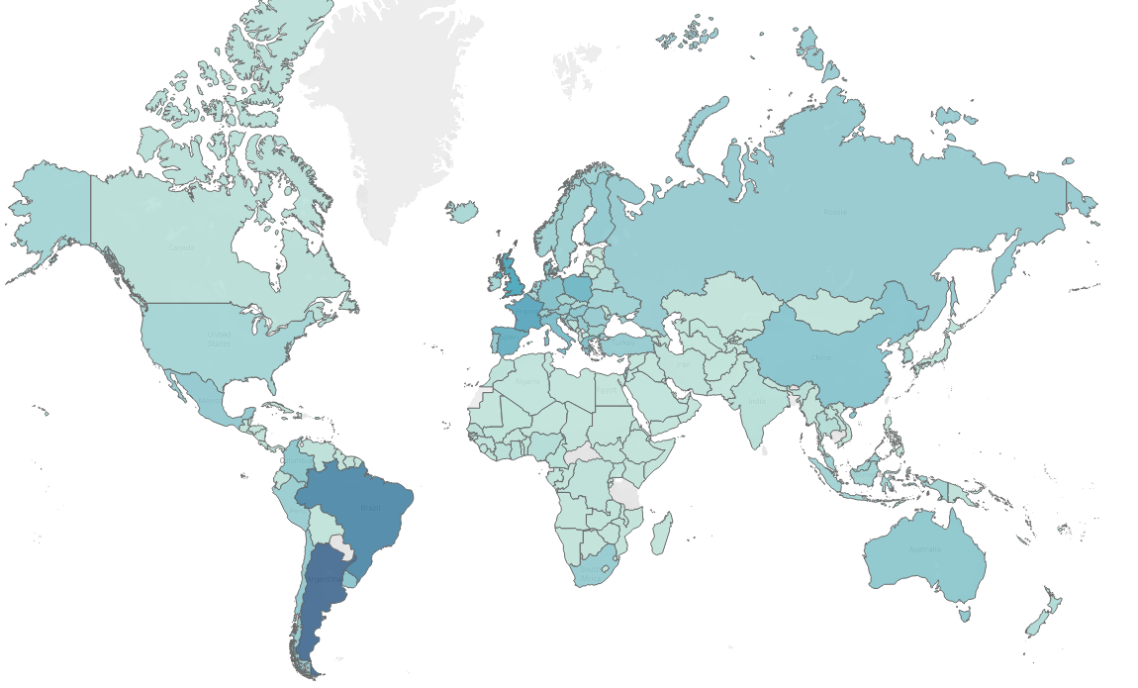

Number of Players per Country

Slide 8
Question 1
Can we predict a player’s Current Ability (CA)?
Used 6 regression Models: MLP, Random Forest, K Nearest Neighbors, Decision Tree, and SVR
The two best models came out to be the Random Forest and MLP models
Evaluations | MLP Regressor | Random Forest Regressor
RMSE | 5.0661 | 6.6949
MSE | 25.6650 | 44.8221
R-squared | 0.9628 | 0.9899
Avg Predicted Difference from actual | 4.0952 | 4.9672
Notes:
75/25 split 75 train 25 test, 56 of the 64 columns were used in the prediction variables

Slide 9
Question 2
Can we predict a player's Potential Ability (PA)?
Used 6 regression Models: MLP, Random Forest, K Nearest Neighbors, Decision Tree, and SVR
The two best models came out to be the Random Forest and MLP models
Evaluations | MLP Regressor | Random Forest Regressor
RMSE | 11.1589 | 11.6928
MSE | 124.5214 | 136.7206
R-squared | 0.8098 | 0.9690
Avg Predicted Difference from actual | 8.5016 | 8.9136
Notes:
75/25 split 75 train 25 test, 56 of the 64 columns were used in the prediction variables

Slide 10
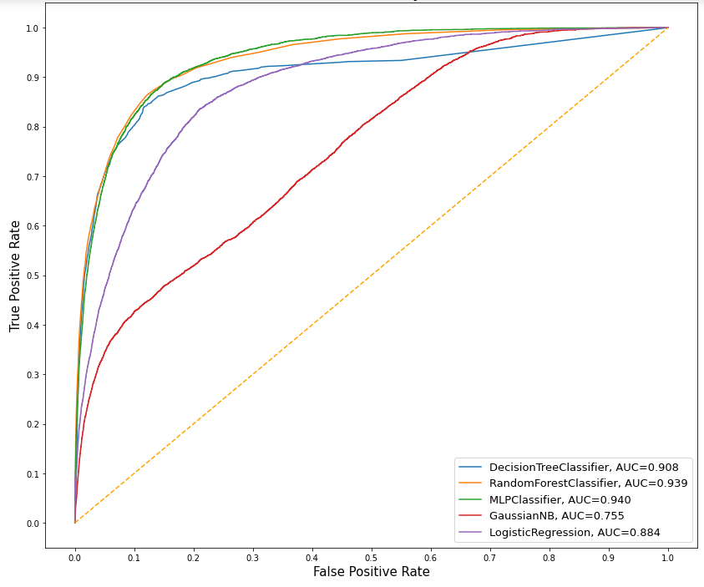
Question 3
Can we predict which players are in a Top 10 league?
Solution: We predicted which players are in a Top 10 League by using five classification models.
The MLP Classifier had the best AUC, Accuracy, Log Loss
The Random Forest Classifier had the fewest false predictions
The Decision Tree had average results
Notes:
MLP wrong in prediction a top league 35% of the time, Did a 60/40 split.

Slide 11
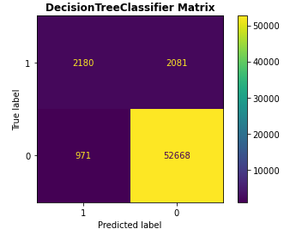
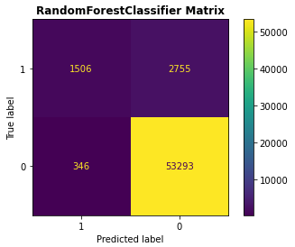
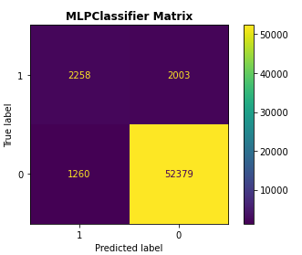
Classification Matrices
Notes:
Good at predicting when a player is NOT in a top league. (Is expected though cause so many more players not in the top 10 leagues)

Slide 12
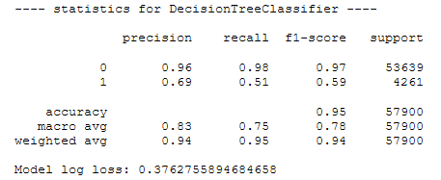
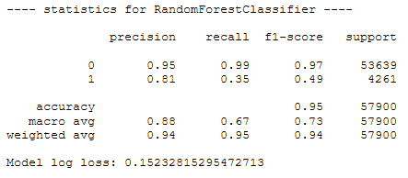
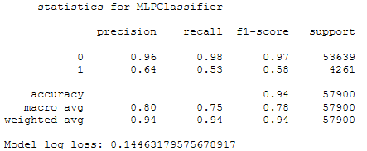
Statistic Evaluations

Slide 13
Dataset Limitations
Like other sports data, this dataset is likely to be incomplete to some degree. There will be errors/omissions and it will not encompass each goal or kick every player has made
This data set also does not include statistics about players’ likelihood of injuries. This likely would have had a tangible effect on players’ long-term Potential Ability
Notes:
Actual likelihood of injury is hidden in the database just not this data set

Slide 14
Future Work
Overall we are content with the outcomes of predicting Potential and current ability from our Regression models
We believe that we can adjust the classification models to better predict if a player is in a top 10 league

Slide 15
Conclusions
We can fairly accurately predict a player’s current ability
Predicting a player’s potential we are not extremely accurate
Our Classification model to predict if a player is in a top 10 league needs some work, most the accuracy comes from predicting a player is not in a top 10 league

Slide 16
Additional Problem - Digit Recognizer
DataSet
digit-recognizer (Kaggle)
This dataset contain pixel values of gray-scale images (28x28) of hand-drawn digits, from zero through nine.
Size: 128MB, 785 Columns, 42,000 Rows
Key Columns: All
Business Question: Can we recognize hand drawn digits?

Slide 17
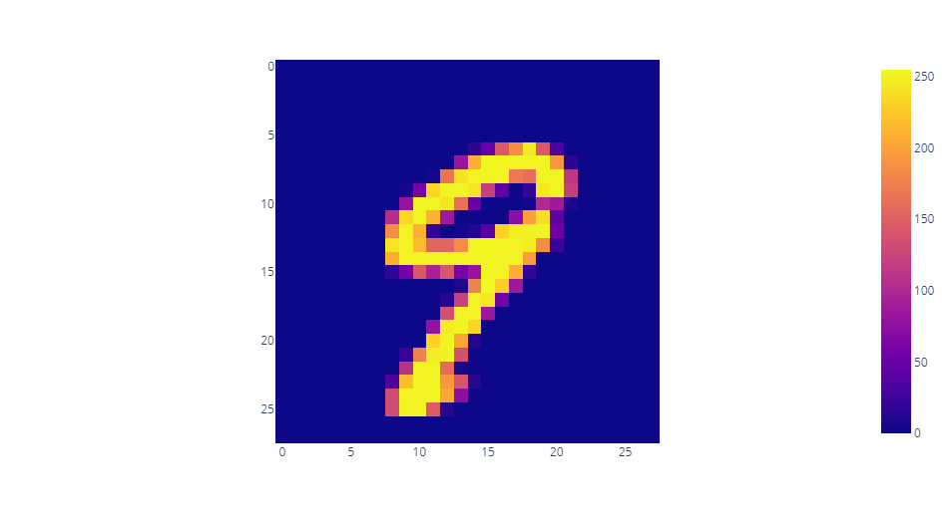
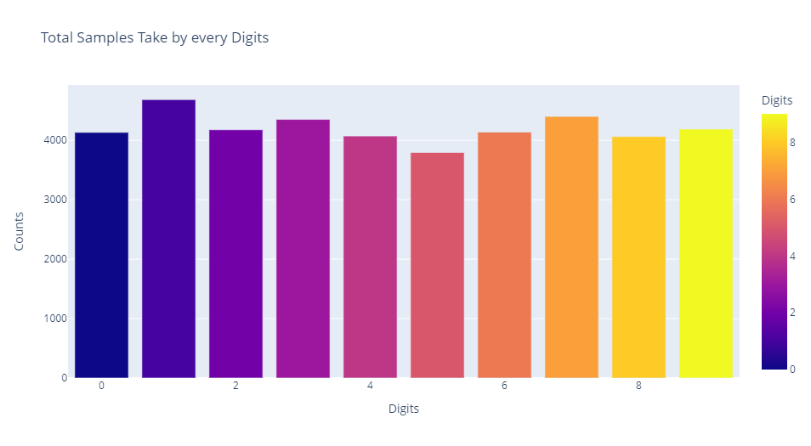
Basic Stats
Frequency of digits
Visuals of digit 9

Slide 18
Solution
We used three classification models for predictions. SVM, Neural Network, and Random Forest.
Random Forest Classifier had the best AUC, Accuracy, F1 score.
SVC_AUC: 0.99961
RF_AUC: 0.99982
MLP_AUC: 0.99875

Slide 19
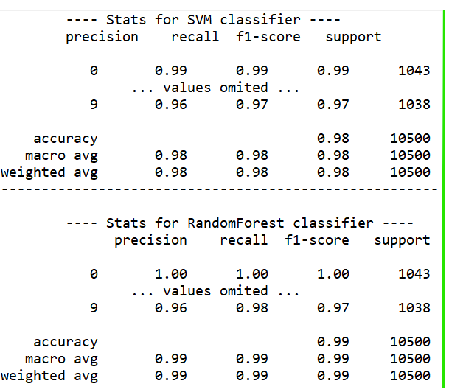
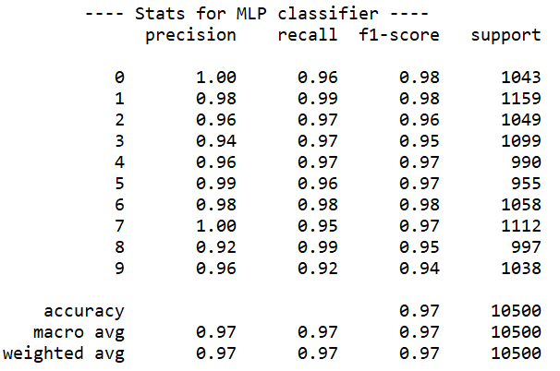
Statistic Evaluations

Slide 20
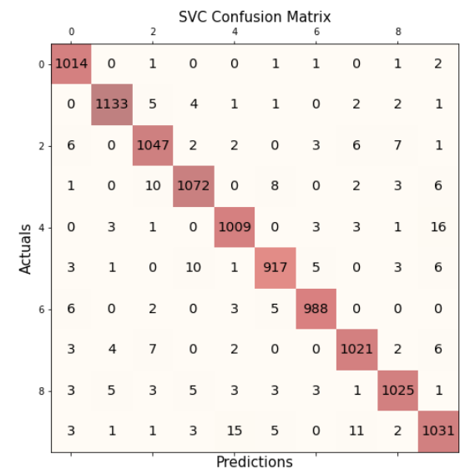
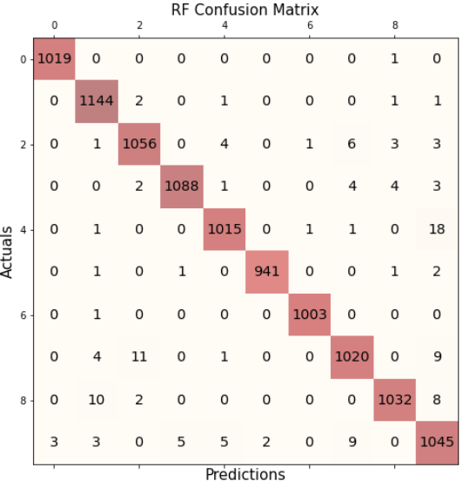
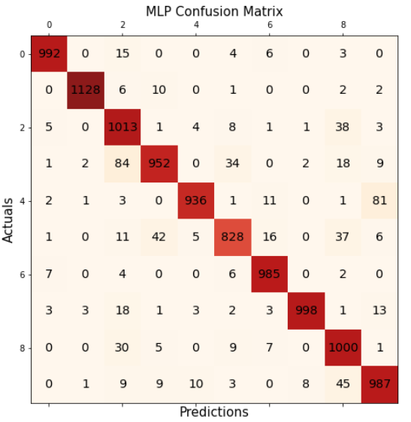
Confusion Matrices

Slide 21
Limitations
Provided test data does not contain actual values.
Predictions using images not supported.
Future Work
Implement methods to use images rather than csv data for predictions.
Conclusion
Used models are fairly good at recognizing digits from grey-scale images.

Slide 22
Thank You!

